Slide 1

HS 2015
Current Trends in Distributed Systems
Final presentation
Group:
Patrick Zumsteg
Simon Wallny
Philipp Oldenburg

Slide 2

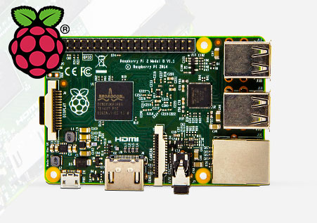

Overview
DBMan
Storm Cluster
Sensor Server
WebServer

Slide 3
Problems
Connection problems
Deploying jars in Apache Storm
Working with a proper protocol
HS 2015
Current Trends in Distributed Systems – Final presentation
<Nummer>

Slide 4
Web Visualization
Apache Web Server
  php Skripts
HTML/CSS side
  Communicating via Jquery to DBMan
Graph Library: CanvasJS
HS 2015
Current Trends in Distributed Systems – Final presentation
<Nummer>

Slide 5
HS 2015
Current Trends in Distributed Systems
Final presentation
Group:
Patrick Zumsteg
Simon Wallny
Philipp Oldenburg

